Slide 1
PHOTOVOLTAIC MATERIALS

Slide 2
Introduction
Photovoltaic(PV) is phenomenon of converting light energy directly to electrical energy

Slide 3
Introduction
Photovoltaic(PV) is phenomenon of converting light energy directly to electrical energy
Some materials on exposure to light generate electricity they are called photovoltaic materials

Slide 4
Introduction
Photovoltaic(PV) is phenomenon of converting light energy directly to electrical energy
Some materials on exposure to light generate electricity they are called photovoltaic materials
Silicon-based semiconductors are the mostly used PV materials these days

Slide 5
Introduction
Photovoltaic(PV) is phenomenon of converting light energy directly to electrical energy
Some materials on exposure to light generate electricity they are called photovoltaic materials
Silicon-based semiconductors are the mostly used PV materials these days
Non-silicon based semiconductors are expected to surpass Silicon based semiconductors in performance and cost

Slide 6
Types of PV cell materials

Slide 7
Types of PV cell materials
Crystalline (Bulk form)

Slide 8
Types of PV cell materials
Crystalline (Bulk form)
Thin film form

Slide 9
Types of PV cell materials
Crystalline (Bulk form)

Slide 10
Types of PV cell materials
Crystalline (Bulk form)
Single crystal
crystal lattice of the entire sample is continuous and unbroken to the edges of the sample, with no grain boundaries

Slide 11
Types of PV cell materials
Crystalline (Bulk form)
Single crystal
crystal lattice of the entire sample is continuous and unbroken to the edges of the sample, with no grain boundaries
Polycrystalline
composed of a number of smaller crystals or crystallites

Slide 12
Types of PV cell materials
Crystalline (Bulk form)
Single crystal
crystal lattice of the entire sample is continuous and unbroken to the edges of the sample, with no grain boundaries
Polycrystalline
composed of a number of smaller crystals or crystallites
Example: Single-crystal Silicon, Polycrystalline Silicon, Gallium Arsenide

Slide 13
Types of PV cell materials
Thin film form

Slide 14
Types of PV cell materials
Thin film form
made by depositing one or more thin layers (thin film) of photovoltaic material on a substrate

Slide 15
Types of PV cell materials
Thin film form
made by depositing one or more thin layers (thin film) of photovoltaic material on a substrate
High absorptivity than crystalline materials

Slide 16
Types of PV cell materials
Thin film form
made by depositing one or more thin layers (thin film) of photovoltaic material on a substrate
High absorptivity than crystalline materials
Faster manufacturing process

Slide 17
Types of PV cell materials
Thin film form
made by depositing one or more thin layers (thin film) of photovoltaic material on a substrate
High absorptivity than crystalline materials
Faster manufacture process
The photovoltaic materials usually are amorphous silicon, nanocrystalline silicon, cadmium telluride etc

Slide 18
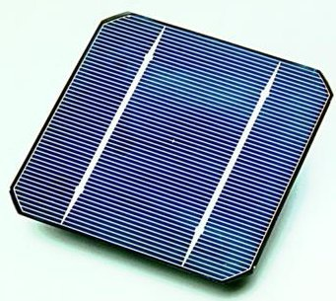
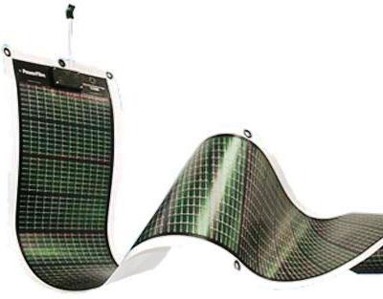
Types of PV cell materials
Crystalline
Thin film form

Slide 19
Role of microstructure on electrical and optical properties

Slide 20
Role of microstructure on electrical and optical properties
Conductivity
monocrystalline > polycrystalline > amorphous

Slide 21
Role of microstructure on electrical and optical properties
Conductivity
monocrystalline > polycrystalline > amorphous
Absorptivity
amorphous > polycrystalline > monocrystalline

Slide 22
Application of photovoltaic in power generation
The solar energy can be directly converted to electricity with the use of a PV cell

Slide 23
Application of photovoltaic in power generation
A single solar cell has very low power
For required power generation cells are interconnected to form module
If the power requirement is even higher the modules are connected together to form array

Slide 24
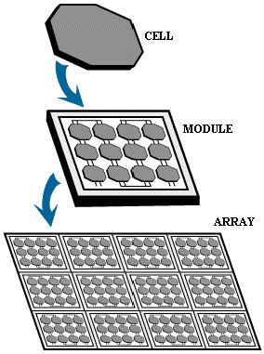
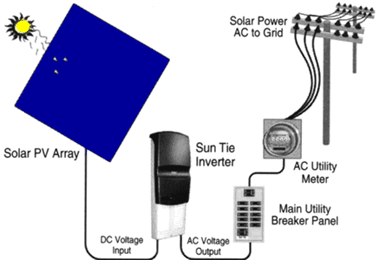
Photovoltaic System
Typical output of a module (~30 cells) is ≈ 15 V, with 1.5 A current

Slide 25
References
en.wikipedia.org
www.powershow.com
www.pveducation.com
www.circuitstoday.com

Slide 26
Thank you!!!

